Slide 1
Spatial and Temporal Variability of Ambient Particulate Matter in California, Texas, and New York
Analysis Conducted by Jordan Janer, Farimah Shirmohammadi, Christine Newkirk, and John Stauffer

Slide 2
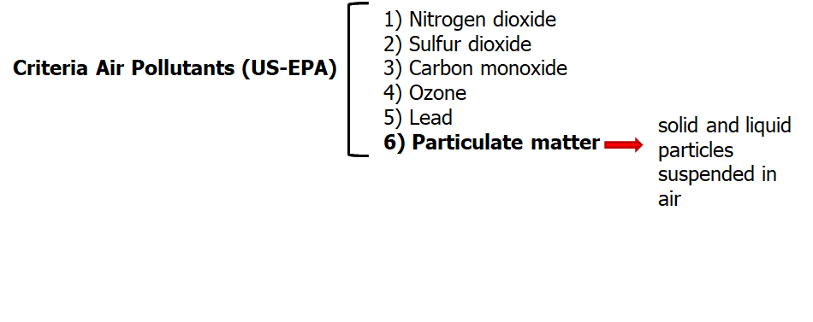
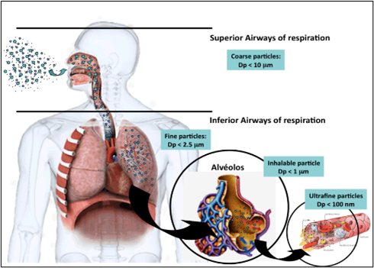
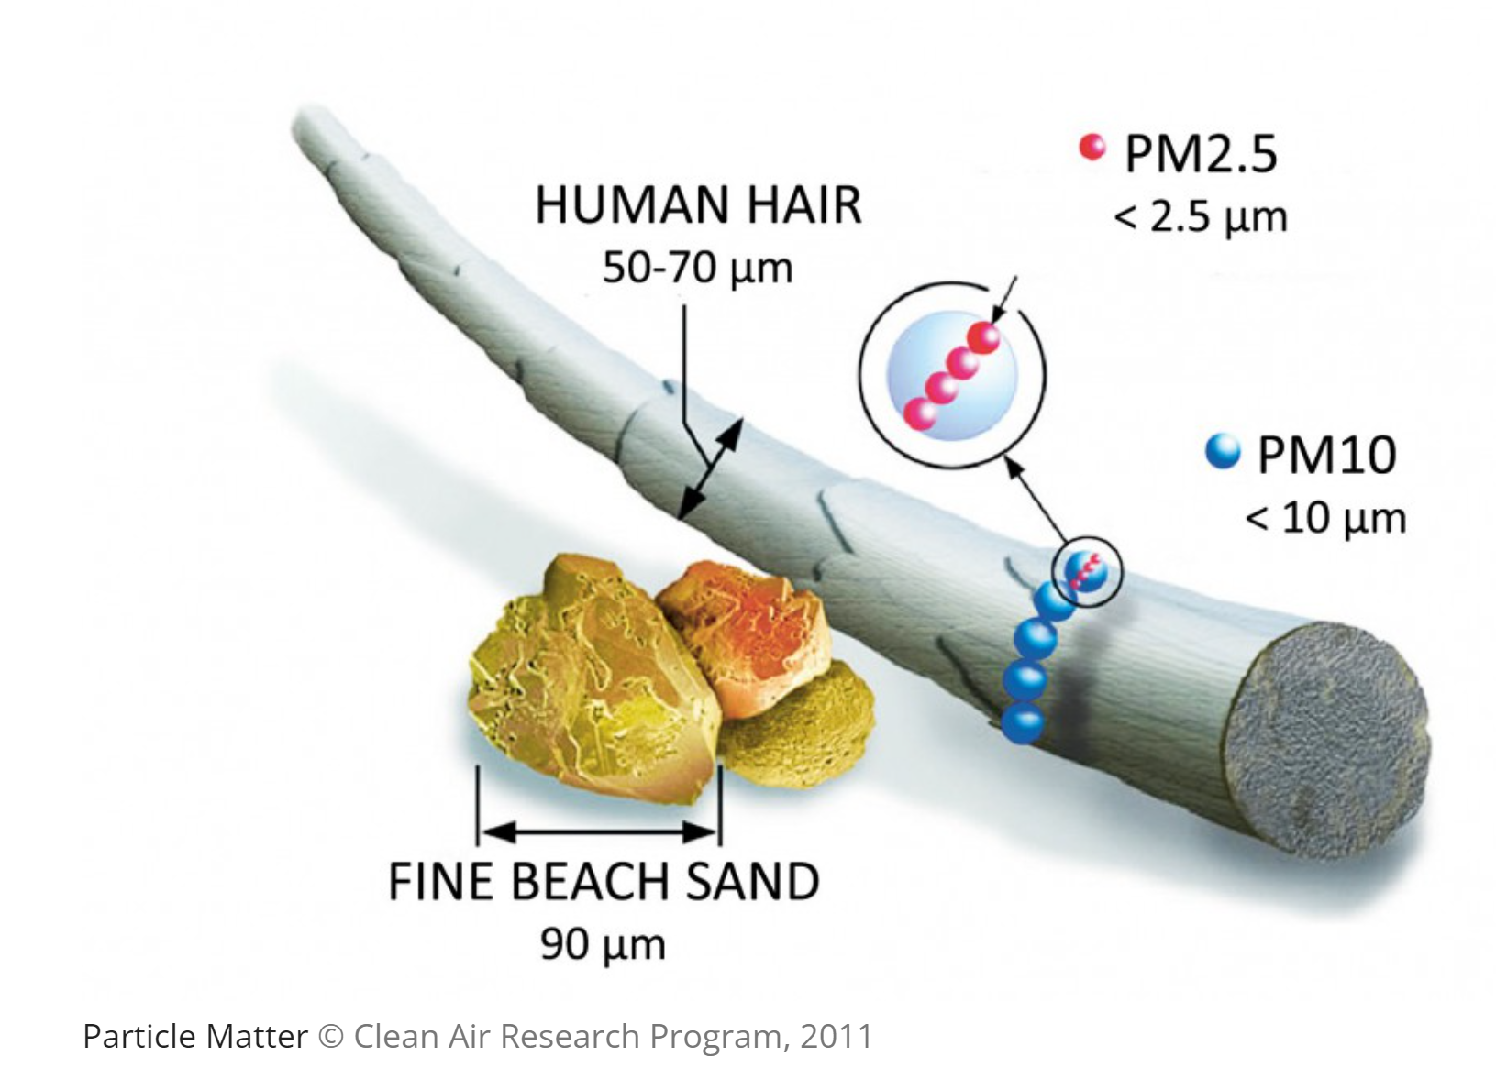
Background: PM definition

Slide 3
Research Questions
Are there differences between California, New York, and Texas in PM2.5 concentrations?
Are there significant differences in PM2.5 concentrations for California between different latitudes?
Are there any seasonal trends or trends throughout the year in PM2.5?

Slide 4
Dataset Used For The Analysis
US-EPA’s Air Quality System (AQS) API
The Air Quality System (AQS) contains ambient air pollution data collected by EPA, state, local, and tribal air pollution control agencies from over thousands of monitors.
For the purpose of this analysis we only looked at PM2.5 levels in three states: CA, NY and TX
Daily
Quarterly
Annual

Slide 5
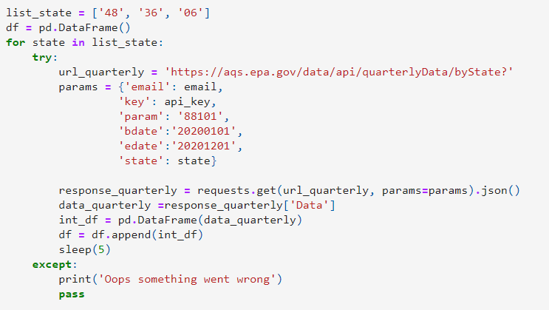

Slide 6
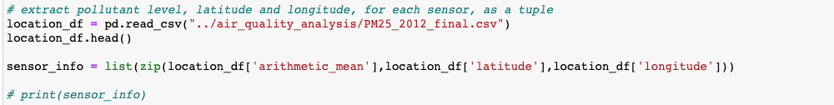
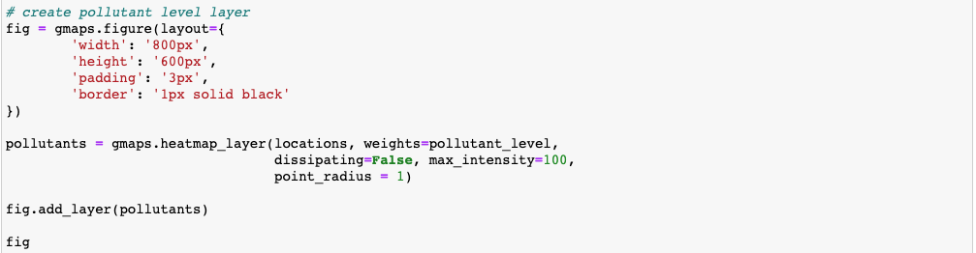
Visualizing the Data
Arithmetic mean PM2.5, latitude and longitude were extracted from the CSV File:
After creating a tuple, and then a dataframe with these values, Google Maps was used to create a heatmap:

Slide 7
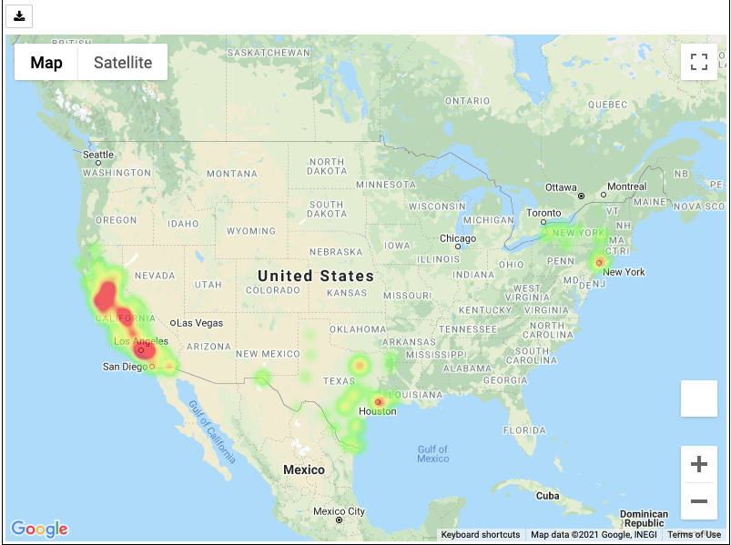
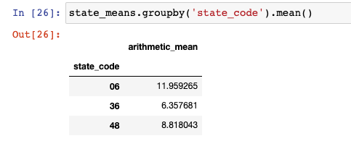
Annual Average PM 2.5 Level by Site (EPA-Annual-Data)
The above heatmap shows the average annual PM2.5 concentration at each sensor for 2020.

Slide 8
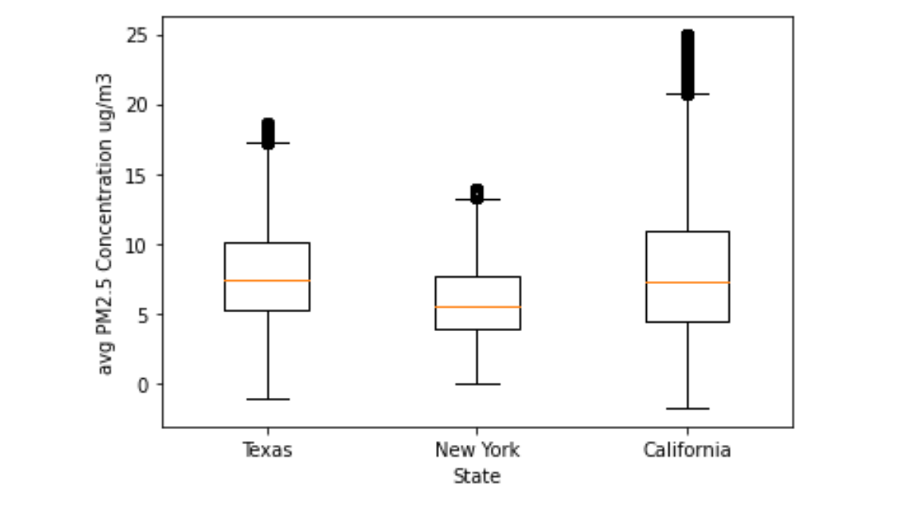
Box Plots of Daily PM2.5 Concentration In The 3 Studied States in Year 2020

Slide 9
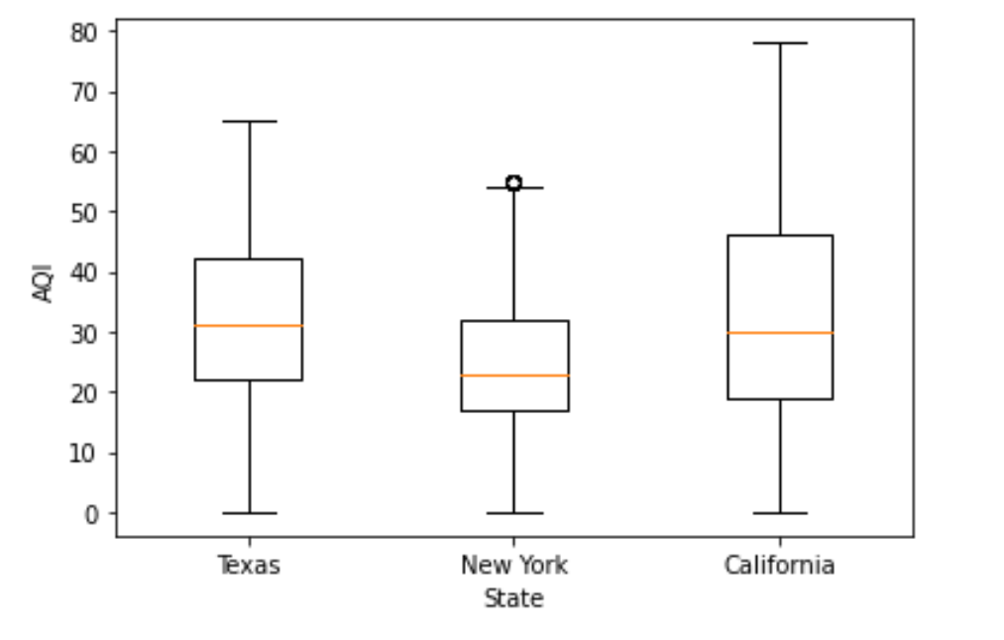
Box Plots of Daily Air Quality Index (AQI) In The 3 Studied States in Year 2020

Slide 10
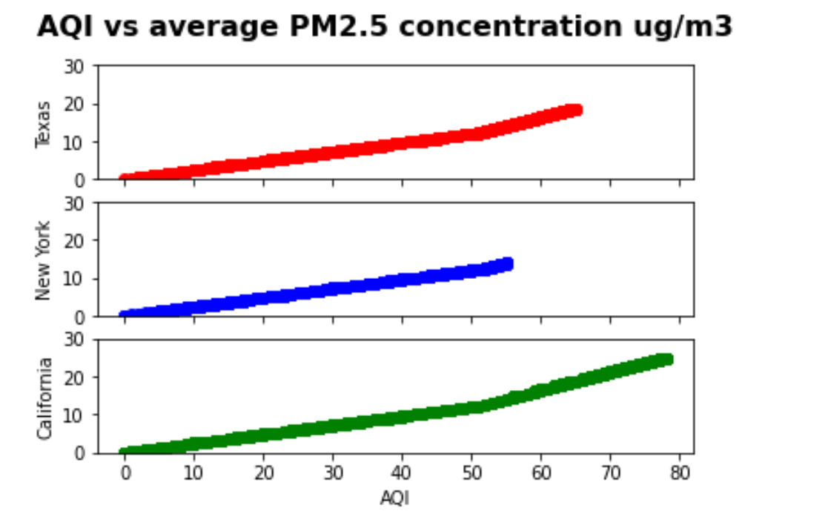

Slide 11
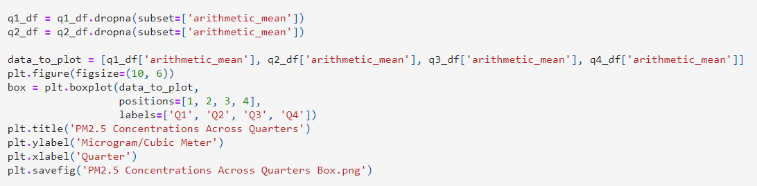

Slide 12
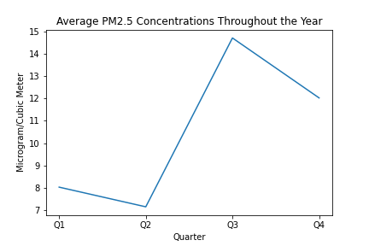
Q1: 8.03 ug/m3
Q2: 7.15 ug/m3
Q3: 14.72 ug/m3
Q4: 12.03 ug/m3

Slide 13
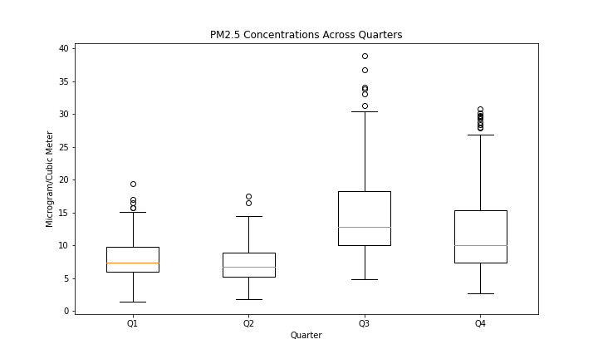
Q1:
25 Percentile = 5.98 ug/m3
Median = 7.37 ug/m3
75 Percentile: 9.75 ug/m3
Q2:
25th Percentile: 5.19 ug/m3
Median: 6.77 ug/m3
75th Percentile: 8.91 ug/m3
Q3:
25th Percentile: 10.02 ug/m3
Median: 12.74 ug/m3
75th Percentile: 18.25 ug/m3
Q4:
25th Percentile: 7.41 ug/m3
Median: 10 ug/m3
75th Percentile: 15.29 ug/m3

Slide 14
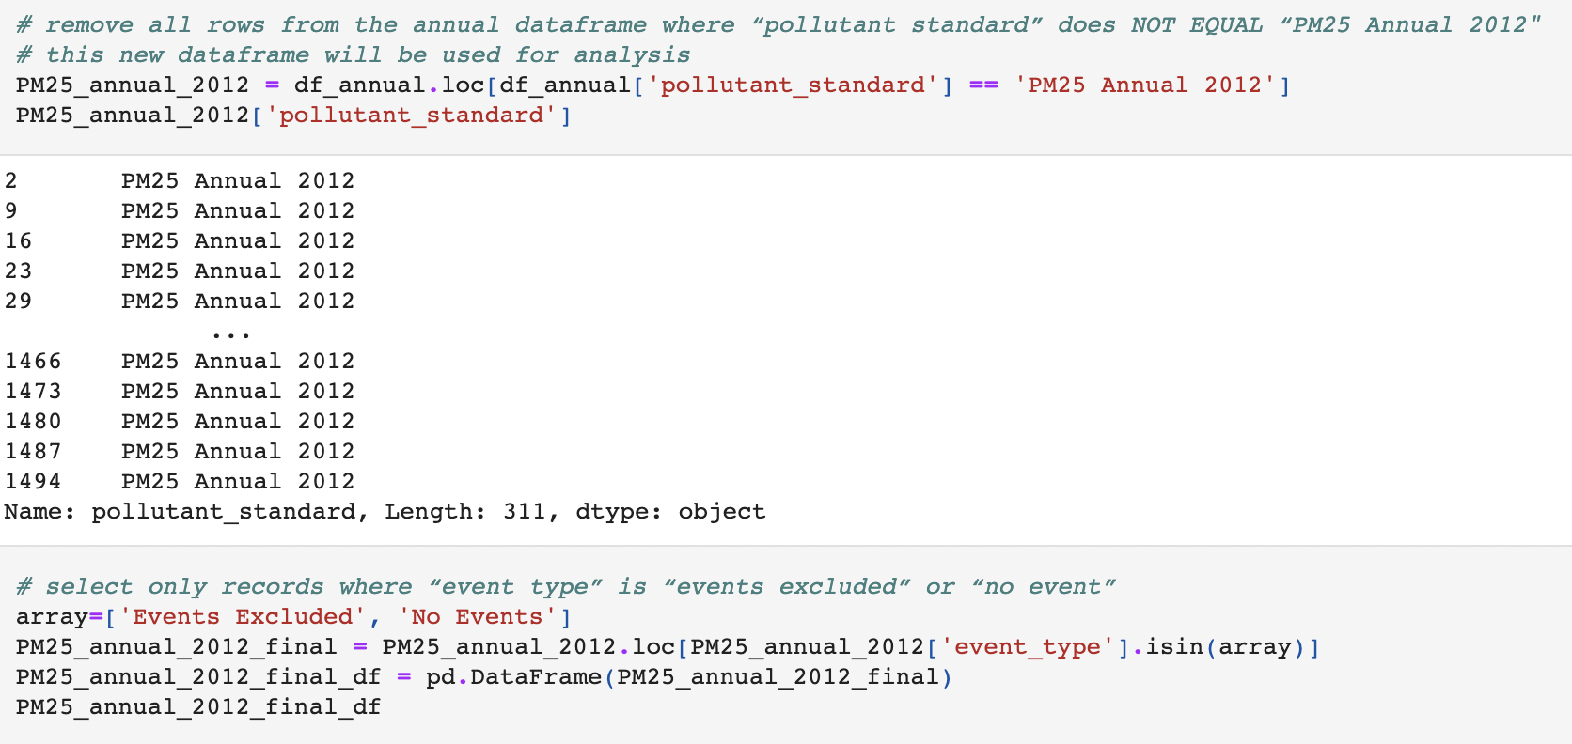

Slide 15
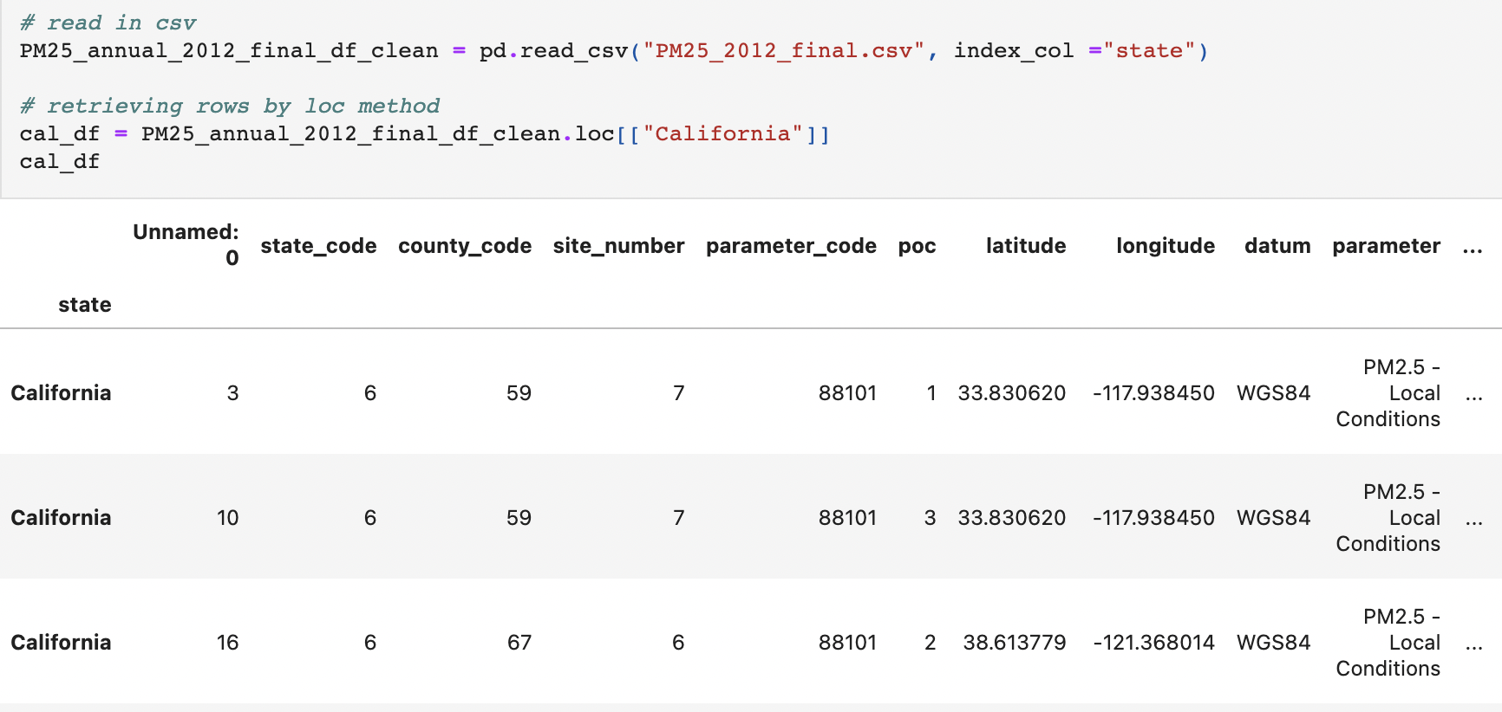

Slide 16
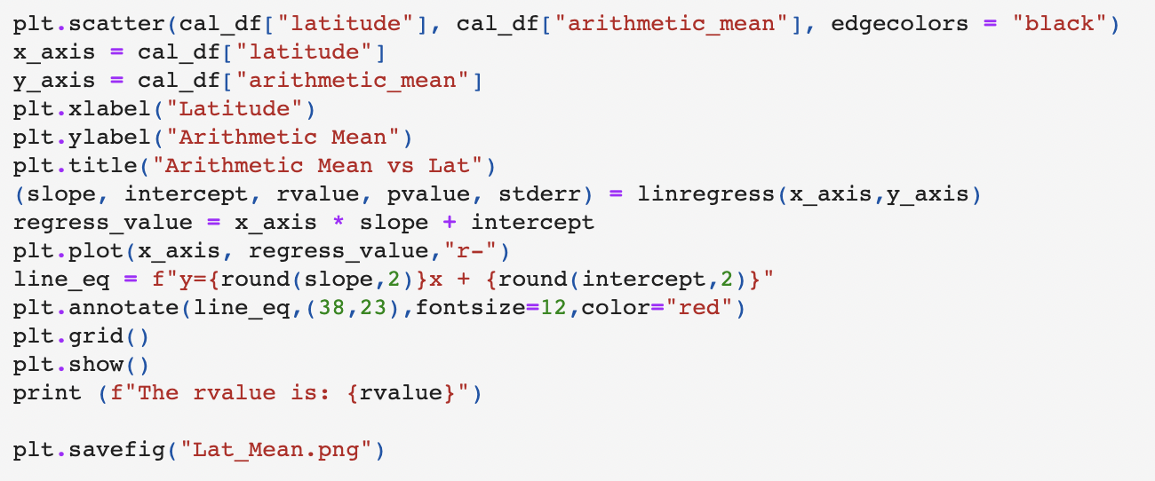
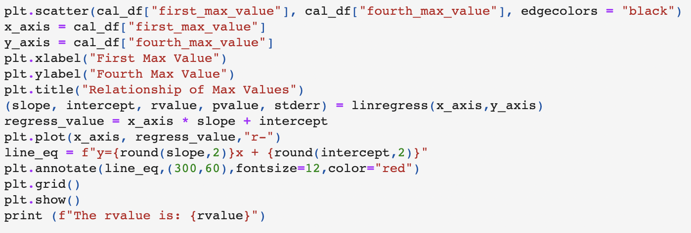
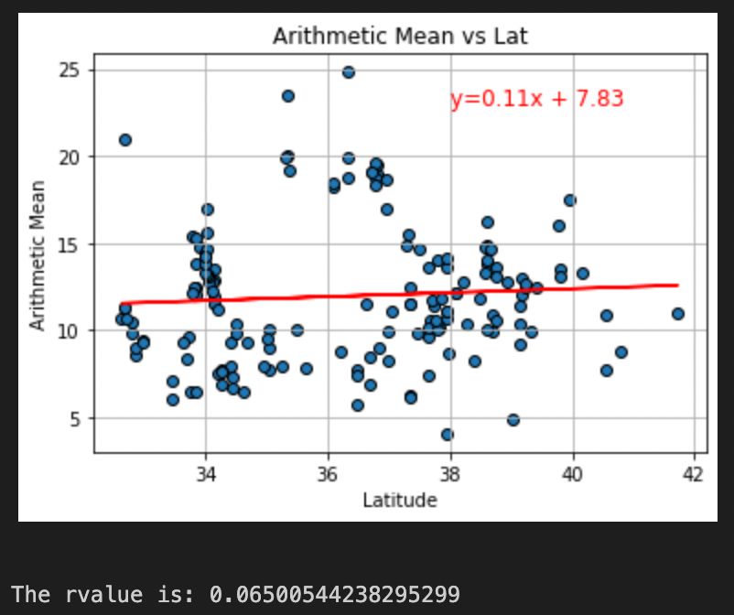
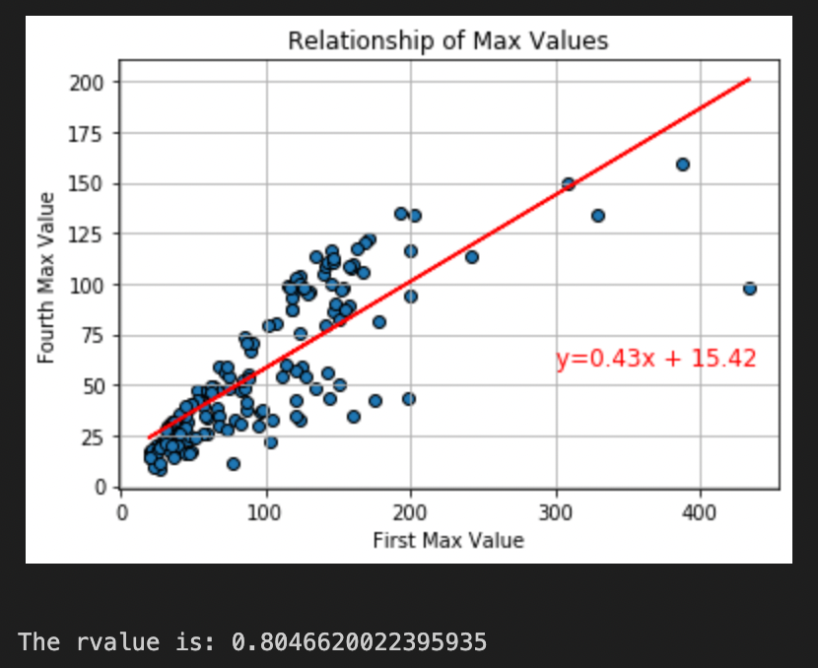
Notes:
After creating the dataframe that was specific to just California locations, we are now able to see if there are significant differences in levels of PM 2.5 for California between different latitudes. Based on the first visual there is really no correlation between the arithmetic means and latitudes in California. This highlights that the latitude does not affect the level of PM 2.5 in California. The second visual shows the correlation between the first max values recorded and the fourth/final max values recorded for the specific site. Based on the visual there is a strong positive correlation which can tell us that depending on the size of first max value it can be projected that the fourth max value will have a similar size.

Slide 17
Conclusion
Based on the findings for just California, there is no difference in air quality based on latitude reported. California has bad air quality in all areas. The first reported values and the fourth reported values from each site does not have any significant change meaning the air quality is consistently unhealthy with little fluctuation.
Based on the findings for quarterly data, it seems that there is an effect of time of year on PM2.5 concentrations. In Q3, there will be the highest concentrations while it will be the lowest in Q2.
The rural areas of the states have better air quality, and the air quality is best in Spring.

